Slide 1
Assignment 4
Read the following specification: Alice, Bob, and Charles live in an apartment. One day Alice is found dead in her room. Please translate the following clues into predicate logic formulas:
(1) A killer always hates, and is no richer than his victim.
(2) Charles hates no one that Alice hates.
(3) Alice hates everybody except Bob.
(4) Bob hates everyone who is either not richer than Alice or hated by Alice.
(5) No one hates everyone.
(6) No one is richer than himself/herself. Who is richer can be determined for any two different persons.
Guess who is the killer and verify your conclusion with semantical entailment.

Slide 2
Solution
Construct a predicate language with the following signature
F={Alice, Bob, Charles}
P={kills, hates, richer}
All predicate symbols have arity 2

Slide 3
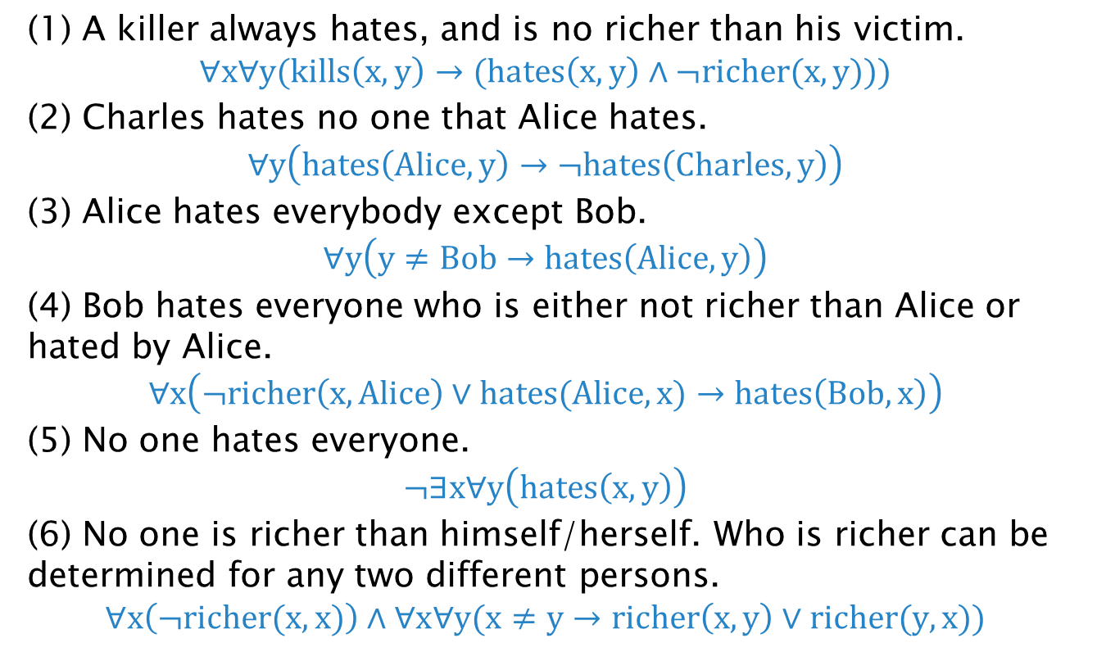
Solution
(1) A killer always hates, and is no richer than his victim.
$$∀x∀y(kills\left(x,y\right)→(hates\left(x,y\right)∧¬richer(x,y)))$$
(2) Charles hates no one that Alice hates.
$$∀y\left(hates\left(Alice,y\right)→¬hates\left(Charles,y\right)\right)$$
(3) Alice hates everybody except Bob.
$$∀y\left(y≠Bob→hates\left(Alice,y\right)\right)$$
(4) Bob hates everyone who is either not richer than Alice or hated by Alice.
$$∀x\left(¬richer\left(x,Alice\right)∨hates(Alice,x)→hates\left(Bob,x\right)\right)$$
(5) No one hates everyone.
$$¬∃x∀y\left(hates\left(x,y\right)\right)$$
(6) No one is richer than himself/herself. Who is richer can be determined for any two different persons.
$$∀x\left(¬richer(x,x)\right)∧∀x∀y(x≠y→richer\left(x,y\right)∨richer(y,x))$$

Slide 4
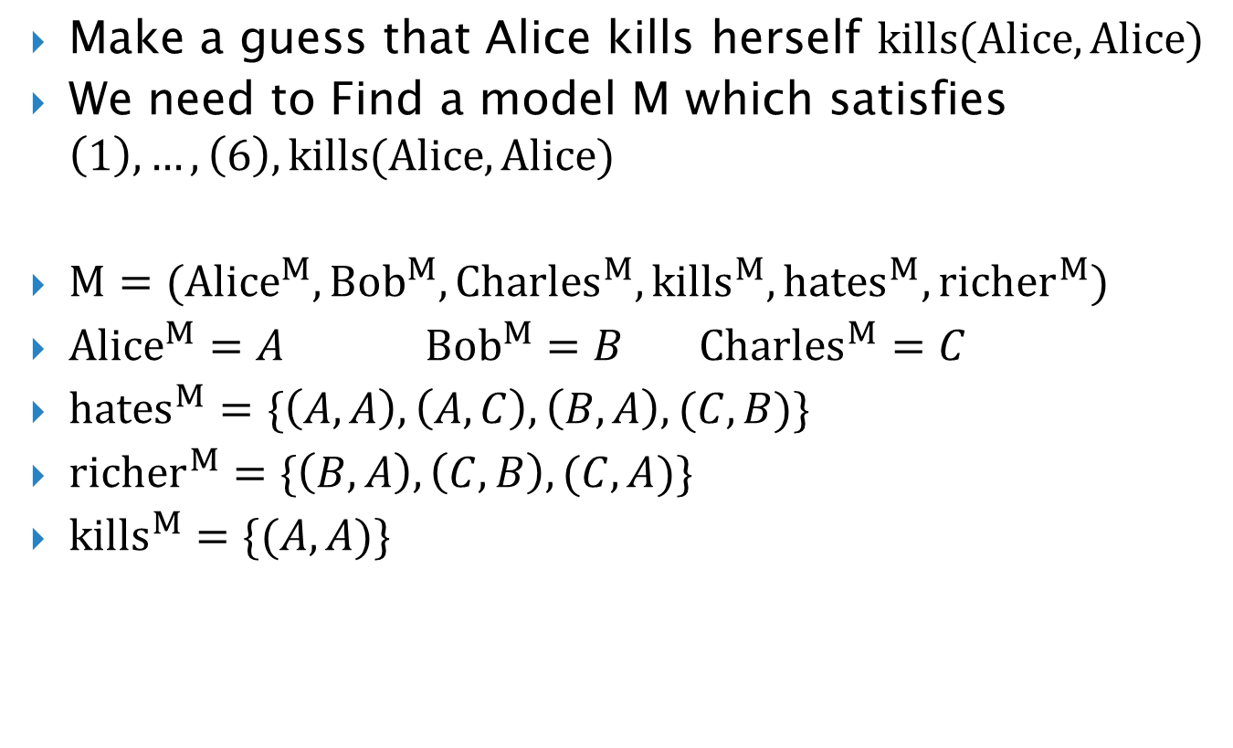
Solution
Make a guess that Alice kills herself $kills(Alice,Alice)$
We need to Find a model M which satisfies $\left(1\right),…,\left(6\right),kills(Alice,Alice)$
$M=({Alice}^{M},{Bob}^{M},{Charles}^{M},{kills}^{M},{hates}^{M},{richer}^{M})$
${Alice}^{M}=A$ ${Bob}^{M}=B$ ${Charles}^{M}=C$
${hates}^{M}=\{\left(A,A\right),\left(A,C\right),\left(B,A\right),(C,B)\}$
${richer}^{M}=\{\left(B,A\right),\left(C,B\right),(C,A)\}$
${kills}^{M}=\{(A,A)\}$

